Slide 1
Windows Store/Phone Apps Getting Started
Gautam Dhameja
Rahul P Nath

Slide 2
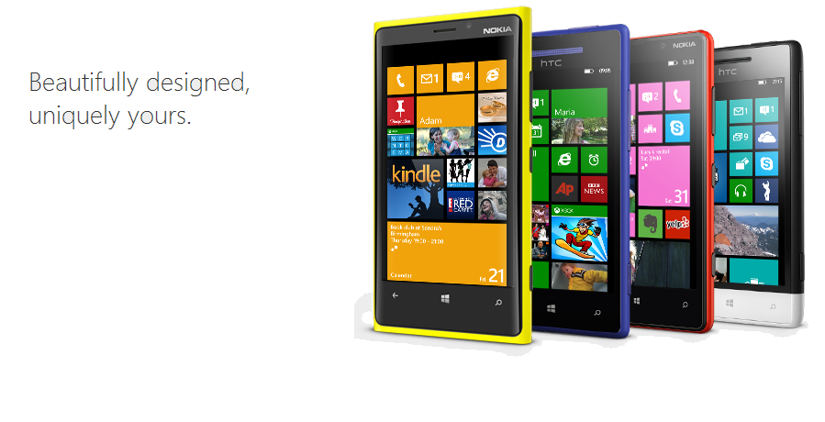
Design principles

Slide 3




Tools
Notes:
https://dev.windowsphone.com
http://appstudio.windowsphone.com

Slide 4
Developing apps
Native
Hybrid
Web
Notes:
Multi-Device Hybrid Apps
http://blogs.msdn.com/b/somasegar/archive/2014/05/12/mobile-first-cloud-first-development-visual-studio-apache-cordova-tooling-and-cloud-optimized-net-futures.aspx
http://msopentech.com/blog/2014/05/12/apache-cordova-integrated-visual-studio/
http://developer.nokia.com/community/wiki/Cross_Platform_Mobile_Architecture

Slide 5
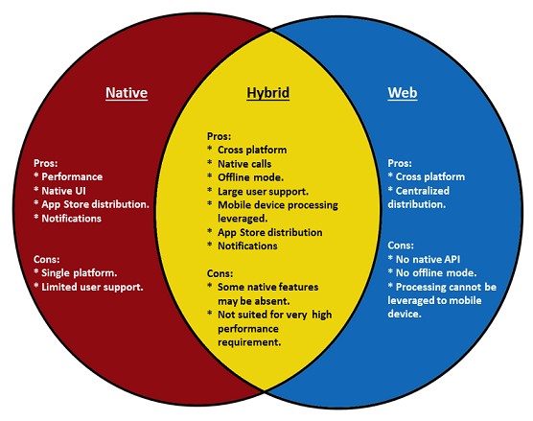
Developing apps

Slide 6
Native
Build for a specific platform with platform SDK, languages and tools
Access to all the native API's.
Platform specific experiences
Performance
Distribution using Store

Slide 7
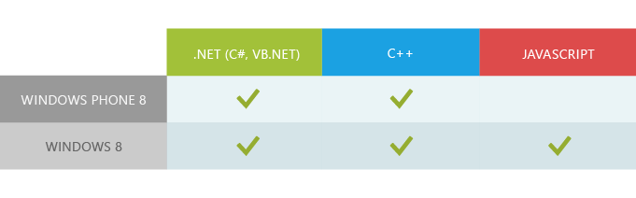
Native
Native
Single Platform
Shared Code (PCL)
Languages

Slide 8
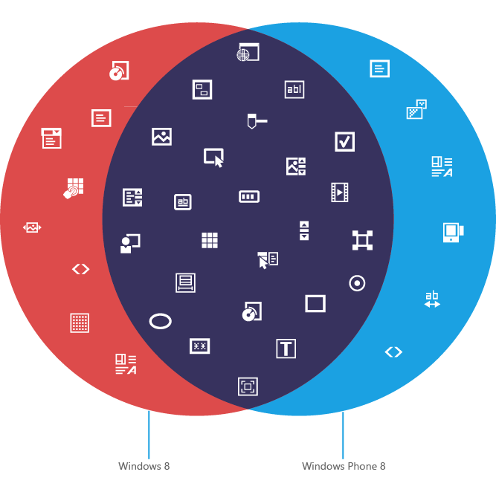
Native - Shared
Notes:
http://msdn.microsoft.com/en-us/library/windowsphone/develop/jj735581(v=vs.105).aspx

Slide 9
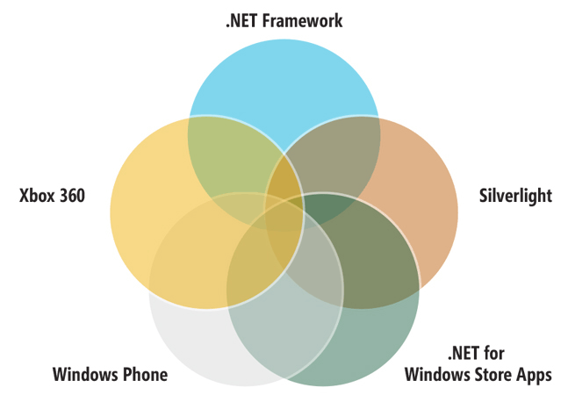
PCL

Slide 10
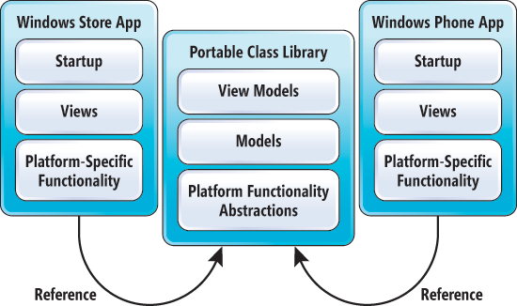
PCL and Code Sharing
Notes:
http://msdn.microsoft.com/en-us/magazine/dn201744.aspx

Slide 11
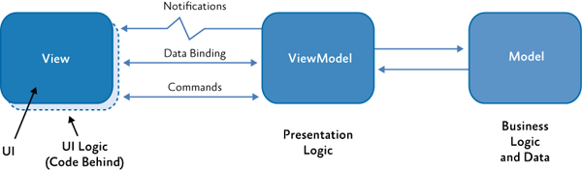
M – V – VM

Slide 12
App Structure: Windows Phone
.xap file structure
One AppManifest.xaml file, which identifies the packaged assemblies and the application entry point.
One application assembly, which includes your application class.
Zero or more library assemblies.
Zero or more loose resource files, such as images or video files.
Notes:
http://msdn.microsoft.com/en-us/library/cc838120(v=vs.95).aspx
Show Demo in VS

Slide 13
App Structure: Windows Store
.appx file structure
App Payload: Code files and assets
App manifest: Declares the app identity, capabilities and deployment information
App block map: Lists all the app files contained in the package along with associated cryptographic hash values
App signature: Ensures that the package and contents haven't been modified after they were signed.
Notes:
http://msdn.microsoft.com/en-in/library/windows/apps/hh464929.aspx
Show Demo in VS

Slide 14
Windows 8 API’s
Two sets of APIs for building Windows Runtime Apps
Windows Runtime
Provides access to all core platform features
WinJS
Provides controls, CSS styles and helper functions
Notes:
Reference
http://msdn.microsoft.com/en-us/library/windows/desktop/br211377.aspx

Slide 15
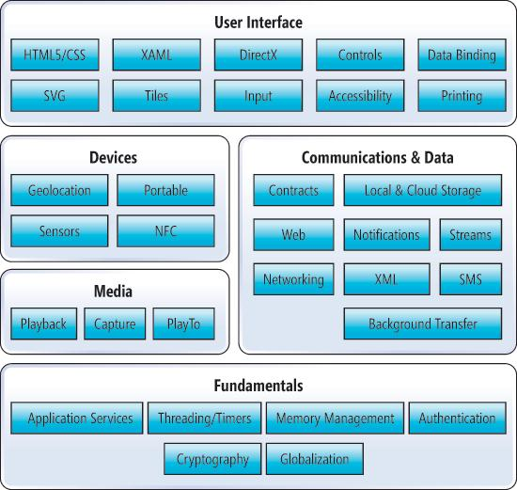
Notes:
http://msdn.microsoft.com/en-us/magazine/jj651567.aspx

Slide 16
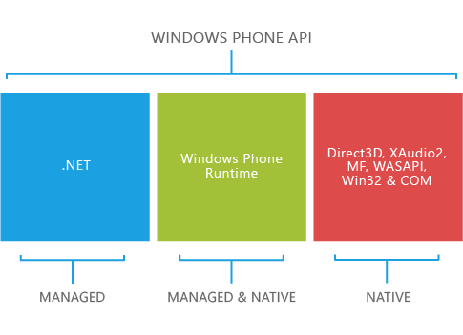
Windows Phone API

Slide 17
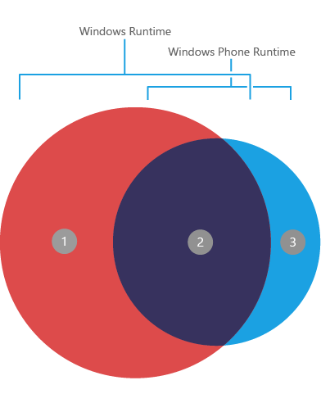
Native
Universal Apps
Multiple Microsoft Platforms
High code reuse
Reduced platform capabilities
(should improve over time)

Slide 18
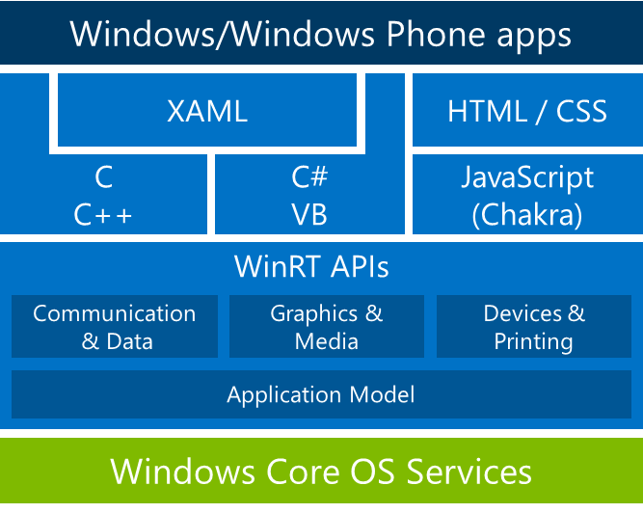
Notes:
http://blogs.msdn.com/b/thunbrynt/archive/2014/03/31/windows-phone-8-1-for-developers-converging-the-app-models.aspx

Slide 19
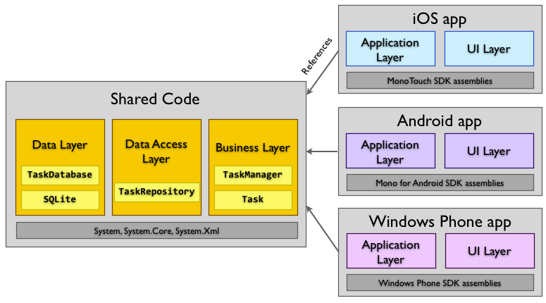
Native
Xamarin
X-plat native
C#
Xamarin Forms
Xamarin.Mobile/Components
MVVM Cross
Notes:
http://developer.xamarin.com/guides/cross-platform/application_fundamentals/building_cross_platform_applications/case_study-tasky/

Slide 20
Hybrid
Hybrid
HTML CSS & JavaScript
Run of multiple platforms and device form factors
Various frameworks provide a web-to-native abstraction layer
Interact with the platform features in a uniform way
Reduced native experience
Performance

Slide 21
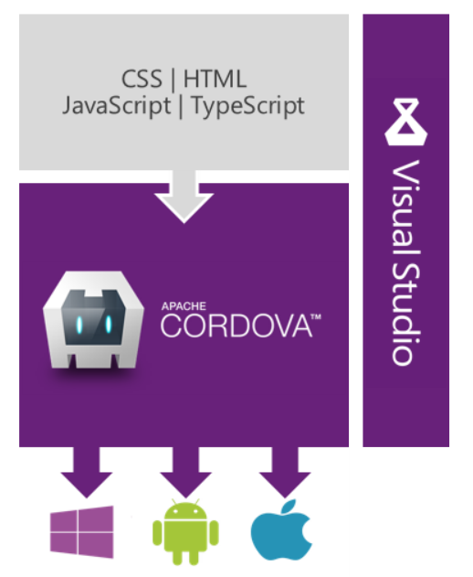
Hybrid
Hybrid
Multi-Device Hybrid Apps
Great Code Editor
Advanced debugging
Testing capabilities
Various open source front-end frameworks like
Angular, Bootstrap, Backbone, Underscore, WinJS
Integration with Microsoft services like Azure, Office 365
Notes:
http://aka.ms/apachecordova

Slide 22
Hybrid
Apache Cordova/PhoneGap
Telerik platform
Sencha touch
Icenium
Notes:
http://propertycross.com/

Slide 23
Web
HTML, CSS and JavaScript
Responsive UI frameworks
No platform support
Notes:
http://propertycross.com/

Slide 24
Data for the application
REST
JSON/XML
Asynchronous Processing

Slide 25
Security
How an end user sees it?
Quality of experience
User’s information
Billable events
Notes:
Building Secure Windows Store Apps <http://blogs.msdn.com/b/cdndevs/archive/2013/03/19/building-secure-windows-store-apps.aspx>
Security for Windows Phone 8 <http://msdn.microsoft.com/en-us/library/windowsphone/develop/ff402533(v=vs.105).aspx>
Delivering reliable and trustworthy Metro style apps <http://blogs.msdn.com/b/b8/archive/2012/05/17/delivering-reliable-and-trustworthy-metro-style-apps.aspx>
Building Secure Windows Phone 8 Apps – APIs and Techniques <http://blogs.msdn.com/b/cdndevs/archive/2013/04/09/building-secure-windows-phone-8-apps-apis-and-techniques.aspx>
Developing secure apps <http://msdn.microsoft.com/en-in/library/windows/apps/hh849625.aspx>
Build secure enterprise apps faster on Windows and Windows Phone 8.1 <http://blogs.windows.com/windows/b/buildingapps/archive/2014/05/12/build-secure-enterprise-apps-faster-on-windows-and-windows-phone-8-1.aspx>
Building Secure Windows Phone 8 Apps – The Platform <http://blogs.msdn.com/b/cdndevs/archive/2013/04/08/building-secure-windows-phone-8-apps-the-platform.aspx>
Windows Phone 8 Security deep dive https://www.msec.be/mobcom/ws2013/presentations/david_hernie.pdf

Slide 26
Ensuring Security - Platform
Structured app submission and certification
Windows Store – maintain consistent set of standards
Sandboxed process
Capabilities

Slide 27
Ensuring Security – Developer
Setting only required capabilities
Data Storage Strategy
Credential Locker for storing credentials (Win8)
Protecting code/Code obfuscation
Notes:
http://blogs.msdn.com/b/cdndevs/archive/2013/03/19/building-secure-windows-store-apps.aspx

Slide 28
Security - Tools
Microsoft SDL Threat Modelling Tool
FxCop
BinScope
BinSearch
MiniFuzz
PoliCheck
JSLint
JSHint
Notes:
http://msdn.microsoft.com/en-us/library/windowsphone/develop/ff402533(v=vs.105).aspx
http://www.microsoft.com/security/sdl/default.aspx

Slide 29
Performance
To Keep users satisfied and engaged
Slow, unresponsive, battery-intensive app experiences are bad
Limited CPU and GPU
Notes:
App performance considerations for Windows Phone 8 <http://msdn.microsoft.com/en-us/library/windowsphone/develop/ff967560(v=vs.105).aspx> App profiling for Windows Phone 8 <http://msdn.microsoft.com/en-us/library/windowsphone/develop/jj215908(v=vs.105).aspx>
Performance Profiling on Windows Phone 8.1 with Visual Studio <http://blogs.msdn.com/b/visualstudioalm/archive/2014/04/03/performance-profiling-on-windows-phone-8-1-with-visual-studio.aspx>
Building High Performance Windows Phone Apps <http://blogs.windows.com/windows_phone/b/wpdev/archive/2013/01/25/building-high-performance-windows-phone-apps.aspx>
Windows Phone Performance–Part 1 of many <http://dotneteers.net/blogs/vbandi/archive/2012/02/15/windows-phone-performance-part-1-of-many.aspx>
Creating high performance Windows Phone apps - THE WHITEPAPER <http://www.jeff.wilcox.name/2010/08/windows-phone-performance/>
Test and troubleshoot apps with the Windows Phone Developer Power Tools <http://msdn.microsoft.com/en-us/library/windows/apps/dn629255.aspx>
Performance (Windows Store apps) <http://msdn.microsoft.com/en-in/library/windows/apps/hh750312.aspx>
Performance best practices for Windows Store apps using C++, C#, and Visual Basic <http://msdn.microsoft.com/en-in/library/windows/apps/hh750313.aspx>
Analyze the performance of Windows Store apps using Visual Studio diagnostic tools <http://msdn.microsoft.com/en-in/library/windows/apps/hh696636.aspx>
Sneak peak: High-Performance Windows Store Apps <http://blogs.msdn.com/b/microsoft_press/archive/2014/03/06/sneak-peak-high-performance-windows-store-apps.aspx>
How to profile a XAML Windows Store App <http://blogs.msdn.com/b/visualstudioalm/archive/2013/02/27/how-to-profile-a-xaml-windows-store-app.aspx>

Slide 30
Plan For Performance
Performance should be planned for, designed and tested
Set performance goals
Design for performance
Instrument apps for performance
Test and measure
Iterate and improve
Notes:
http://msdn.microsoft.com/en-in/library/windows/apps/dn391697.aspx

Slide 31
Performance Considerations
Images
Use appropriate image format
Image decoding in background threads
Images instead of xaml when visuals are static
Image sizes
Media
Encode media for optimal playback rate and resolution
Notes:
http://msdn.microsoft.com/en-us/library/windows/apps/hh465194.aspx

Slide 32
Performance Considerations
Hiding and Displaying objects
Visibility vs Opacity with bitmap caching
Indicate Progress
App Startup
Splash Screen
Minimize size of app assemblies
Avoid Blocking UI Thread
Notes:
http://msdn.microsoft.com/en-us/library/windowsphone/develop/ff967560(v=vs.105).aspx#BKMK_Images

Slide 33
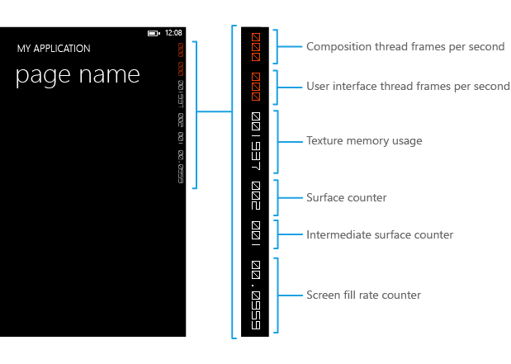
Performance - Tools
Visual Studio
Frame Rate Counters
Windows Performance
Toolkit
Notes:
http://msdn.microsoft.com/en-us/library/windows/apps/jj553524.aspx
http://msdn.microsoft.com/en-us/library/windows/apps/dn391693.aspx
http://msdn.microsoft.com/en-us/library/windows/apps/dn391695.aspx
http://msdn.microsoft.com/en-us/library/windowsphone/develop/ff967560(v=vs.105).aspx#BKMK_Tools
http://msdn.microsoft.com/en-in/library/windows/apps/hh162945.aspx

Slide 34
Testing
Responds to different settings
Resolution
Orientation
State
Language
Region
Notes:
http://msdn.microsoft.com/en-us/library/windowsphone/develop/jj247547(v=vs.105).aspx
Testing Windows Phone apps <http://msdn.microsoft.com/en-us/library/windows/apps/dn629256.aspx>
Testing Windows Store apps <http://msdn.microsoft.com/en-us/library/hh405417.aspx>
Debugging and testing Store apps with Visual Studio <http://msdn.microsoft.com/en-in/library/windows/apps/hh441481.aspx>
Using Coded UI to test XAML-based Windows Store apps <http://blogs.msdn.com/b/visualstudioalm/archive/2013/06/26/using-coded-ui-to-test-xaml-based-windows-store-apps.aspx>
Testing for accessibility in Windows Store apps <http://blogs.windows.com/windows/b/appbuilder/archive/2014/03/25/testing-for-accessibility-in-windows-store-apps.aspx>

Slide 35
Testing
Special Features
Copy-and-paste
Location
Accelerometer
Launchers & Choosers

Slide 36
Testing
Reliability and Resource usage
Unit Tests
Network Connection
Usage of resources
Responsiveness

Slide 37
Emulator support
Screen resolution, size and memory
Orientation
Networking
Language and Region settings
Application state
Microphone
Lock screen
Notes:
http://msdn.microsoft.com/en-us/library/windows/apps/dn629256.aspx

Slide 38
Only Physical Device
Compass
Gyroscope
Vibration
Brightness

Slide 39
Prepare for store
Certification requirements
Names and Icons
App Description
App screenshots

Slide 40
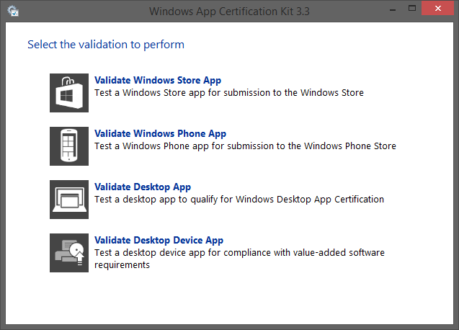
Prepare for store - WACK
Notes:
WACK tool

Slide 41
Prepare for store - WACK
Notes:
WACK tool

Slide 42
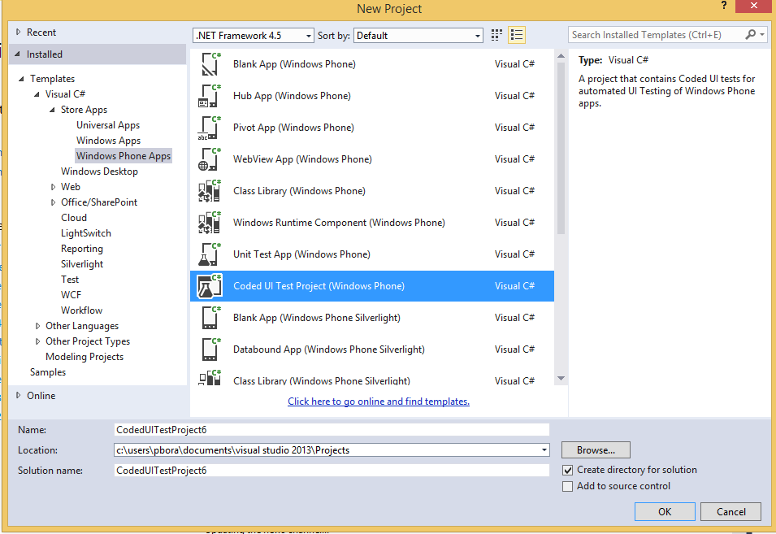
Coded UI for Windows Phone
All touch gestures supported
Tests run from Visual Studio
Testing using UI maps

Slide 43
App Protocols
The ability to call on app from another
Protocols are associated with apps
Once an app invokes protocol of another app, that app is started
Protocols can even be invoked from web apps

Slide 44
Preview Features
Brokered Windows Runtime Components for side-loaded applications
To reuse the existing enterprise software assets that are developed using .net APIs which are not allowed in Store Apps
Only side-loaded app can use this feature
Based on Inter Process Communication

Slide 45
What next?
Channel 9
Microsoft Virtual Academy

Slide 46
Q & A

Slide 47
Stay Healthy,
Code Well
and Keep
in touch
@rahulpnath
@techgd
http://rahulpnath.com
@rahulpnath
@techgd

